Slide 1
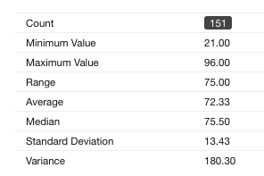
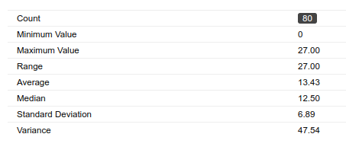
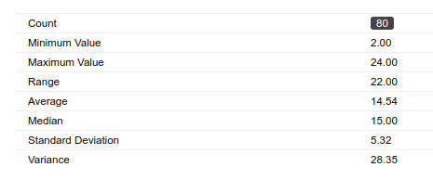
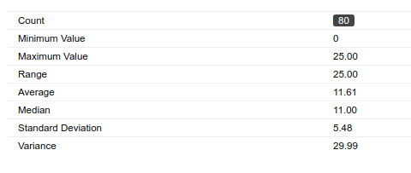
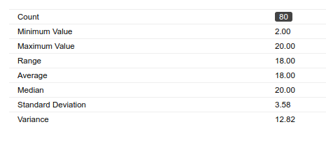
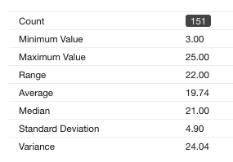
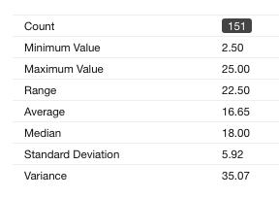
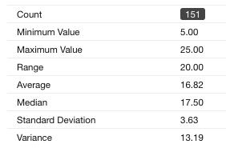
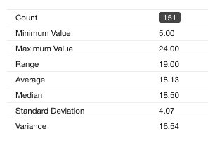
Midterms
PAC Learning SVM Kernels+Boost Decision Trees
Notes:
Most simple, and in some sense most general is the mult-class classification problem
describe each one...
Say: ALL OF THESE TASKS have a fairly limited output space...
IN THAT: NUMBER OF CLASSES IS PRETTY SMALL...
THIS ISN”T ALWAYS THE CASE

Slide 2
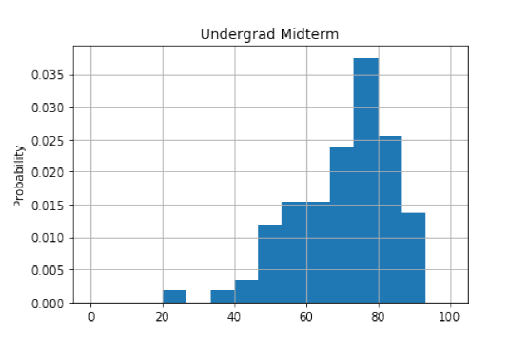
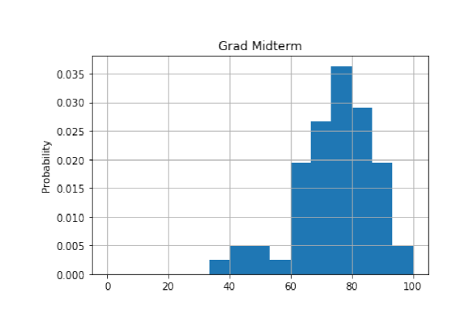
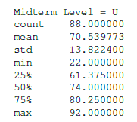
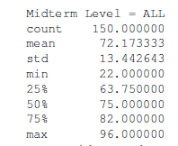
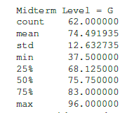
Midterms
Grades are on a curve
Will be available at the TA sessions this week
Projects feedback has been sent.
Recall that this is 25% of your grade!
Notes:
Most simple, and in some sense most general is the mult-class classification problem
describe each one...
Say: ALL OF THESE TASKS have a fairly limited output space...
IN THAT: NUMBER OF CLASSES IS PRETTY SMALL...
THIS ISN”T ALWAYS THE CASE

Slide 3
Classification
So far we focused on Binary Classification
For linear models:
Perceptron, Winnow, SVM, GD, SGD
The prediction is simple:
Given an example x,
Prediction = sgn(w^{T}x)
Where w is the learned model
The output is a single bit

Slide 4
Multi-Categorical Output Tasks
Multi-class Classification (y ∈ {1,...,K})
character recognition (‘6’)
document classification (‘homepage’)
Multi-label Classification (y ⊆ {1,...,K})
document classification (‘(homepage,facultypage)’)
Category Ranking (y ∈ π(K))
user preference (‘(love > like > hate)’)
document classification (‘hompage > facultypage > sports’)
Hierarchical Classification (y ⊆ {1,..,K})
cohere with class hierarchy
place document into index where ‘soccer’ is-a ‘sport’
Notes:
Most simple, and in some sense most general is the mult-class classification problem
describe each one...
Say: ALL OF THESE TASKS have a fairly limited output space...
IN THAT: NUMBER OF CLASSES IS PRETTY SMALL...
THIS ISN”T ALWAYS THE CASE

Slide 5
Setting
Learning:
Given a data set D = {(x_{i} , y_{i})}₁^{m}
Where x_{i} 2 R^{n}, y_{i} 2 {1,2,…,k}.
Prediction (inference):
Given an example x, and a learned function (model),
Output a single class labels y.

Slide 6
Binary to Multiclass
Most schemes for multiclass classification work by reducing the problem to that of binary classification.
There are multiple ways to decompose the multiclass prediction into multiple binary decisions
One-vs-all
All-vs-all
Error correcting codes
We will then talk about a more general scheme:
Constraint Classification
It can be used to model other non-binary classification schemes and leads to Structured Prediction.

Slide 7
One-Vs-All
Assumption: Each class can be separated from all the rest using a binary classifier in the hypothesis space.
Learning: Decomposed to learning k independent binary classifiers, one for each class label.
Learning:
Let D be the set of training examples.
8 label l, construct a binary classification problem as follows:
Positive examples: Elements of D with label l
Negative examples: All other elements of D
This is a binary learning problem that we can solve, producing k binary classifiers w₁, w₂, …w_{k}
Decision: Winner Takes All (WTA):
f(x) = argmax_{i} w_{i}^{T}x

Slide 8
Solving MultiClass with 1vs All learning
MultiClass classifier
Function f : R^{n} → {1,2,3,...,k}
Decompose into binary problems
Not always possible to learn
No theoretical justification
Need to make sure the range of all classifiers is the same
(unless the problem is easy)
Notes:
Most work in ML is for the BINARY problem
Well understood (Theory)
Many algorithms work well (Practice)
Therefore
Tempting and DESIREABLE to use binary algs to solve multiclass
The most common approach : **OvA**
Learn a set of classifiers: one for each class versus the rest
Notice however, that while it may be possilbe to find such a classifier
-NOT ALWAYS THE CASE.
In the last partition here, it is impossible to separate the red points
from the rest using a linear function.
Therefore this classifier will FAIL
**No theoretical justification unless the problem is easy**

Slide 9
Learning via One-Versus-All (OvA) Assumption
Find v_{r},v_{b},v_{g},v_{y} ∈ R^{n} such that
v_{r}.x > 0 iff y = red ⊗
v_{b}.x > 0 iff y = blue √
v_{g}.x > 0 iff y = green √
v_{y}.x > 0 iff y = yellow √
Classification: f(x) = argmax_{i} v_{i} x
H = R^{nk}
Real Problem
Notes:
OvA (one versus all)
learn k independent classifiers
each separate one class from rest
blue, yellow, green – works fine
red – impossible
It’s possible that f(x) WILL classify correctly
Can be shown that it may not
Look at decision surface.
Colored regions, THERE IS NO DISPUTE FROM CLASSIFIERS
Black – all will be less than zero
the rest depend on the magnitude of weight vectors
... and how they are found
IF RED HAS HIGH MAG → will dominate classification
OVA uses rich enough rep
Learning technique is inadequate
binary classifiers it uses don’t have enough information

Slide 10
All-Vs-All
Assumption: There is a separation between every pair of classes using a binary classifier in the hypothesis space.
Learning: Decomposed to learning [k choose 2] ~ k² independent binary classifiers, one corresponding to each pair of class labels. For the pair (i, j):
Positive example: all exampels with label i
Negative examples: all examples with label j
Decision: More involved, since output of binary classifier may not cohere. Each label gets k-1 votes.
Decision Options:
Majority: classify example x to take label i if i wins on x more often than j (j=1,…k)
A tournament: start with n/2 pairs; continue with winners .

Slide 11
Learning via All-Verses-All (AvA) Assumption
It is possible to separate all k classes with the O(k²) classifiers
Find v_{rb},v_{rg},v_{ry},v_{bg},v_{by},v_{gy} ∈ R^{d} such that
v_{rb}.x > 0 if y = red
< 0 if y = blue
v_{rg}.x > 0 if y = red
< 0 if y = green
... (for all pairs)
H = R^{kkn}
How to classify?
Individual
Classifiers
Decision
Regions
Notes:
[ GENERAL NOTE: Focus on diagram, say it’s more powerful than WTA]
AvA (All versus all)
expand representation space
learn (k choose 2) classifiers
separate each pair of classes
for example Vred,green separates all red points from greed points
Decision Surface
Can cover any example set the WTA can generate
BUT
1. TOO COMPLEX
2. AMBIGUOUS – Black regions are unknown
tournament or majority vote necessary

Slide 12
Classifying with AvA
Tournament
Majority Vote
1 red, 2 yellow, 2 green
➔ ?
All are post-learning and might cause weird stuff

Slide 13
One-vs-All vs. All vs. All
Assume m examples, k class labels.
For simplicity, say, m/k in each.
One vs. All:
classifier f_{i}: m/k (+) and (k-1)m/k (-)
Decision:
Evaluate k linear classifiers and do Winner Takes All (WTA):
f(x) = argmax_{i} f_{i}(x) = argmax_{i} w_{i}^{T}x
All vs. All:
Classifier f_{ij}: m/k (+) and m/k (-)
More expressivity, but less examples to learn from.
Decision:
Evaluate k² linear classifiers; decision sometimes unstable.
What type of learning methods would prefer All vs. All (efficiency-wise)?
(Think about Dual/Primal)

Slide 14
Error Correcting Codes Decomposition
1-vs-all uses k classifiers for k labels; can you use only log₂ k?
Reduce the multi-class classification to random binary problems.
Choose a “code word” for each label.
K=8: all we need is 3 bits, three classifiers
Rows: An encoding of each class (k rows)
Columns: L dichotomies of the data, each corresponds to a new classification problem
Extreme cases:
1-vs-all: k rows, k columns
k rows log₂ k columns
Each training example is mapped to one example per column
(x,3) → {(x,P1), +; (x,P2), -; (x,P3), -; (x,P4), +}
To classify a new example x:
Evaluate hypothesis on the 4 binary problems
{(x,P1) , (x,P2), (x,P3), (x,P4),}
Choose label that is most consistent with the results.
Use Hamming distance (bit-wise distance)
Nice theoretical results as a function of the performance of the P_{i} s (depending on code & size)
Potential Problems?
Label | P1 | P2 | P3 | P4
1 | - | + | - | +
2 | - | + | + | -
3 | + | - | - | +
4 | + | - | + | +
k | - | + | - | -
Can you separate any dichotomy?
Notes:
However, a PROBLEM W/ DECOMPOSITION TECHNIQUES
Induced Binary problems are optimized INDEPENDENTLY
NO GLOBAL METRIC IS USED.
FOR EXAMPLE, in MC,
we don’t care about 1 vs rest performance
only about the FINAL MC Classification
TRANSISTION:
We can look at a simple example:

Slide 15
Problems with Decompositions
Learning optimizes over local metrics
Does not guarantee good global performance
We don’t care about the performance of the local classifiers
Poor decomposition ⇒ poor performance
Difficult local problems
Irrelevant local problems
Especially true for Error Correcting Output Codes
Another (class of) decomposition
Difficulty: how to make sure that the resulting problems are separable.
Efficiency: e.g., All vs. All vs. One vs. All
Former has advantage when working with the dual space.
Not clear how to generalize multi-class to problems with a very large # of output variables.
Notes:
However, a PROBLEM W/ DECOMPOSITION TECHNIQUES
Induced Binary problems are optimized INDEPENDENTLY
NO GLOBAL METRIC IS USED.
FOR EXAMPLE, in MC,
we don’t care about 1 vs rest performance
only about the FINAL MC Classification
TRANSISTION:
We can look at a simple example:

Slide 16
A sequential model for multiclass classification
A practical approach: towards a pipeline model
As before: relies on a decomposition of the Y space
This time, a hierarchical decomposition
(but sometimes the X space is also decomposed)
Goal: Deal with large Y space.
Problem: the performance of a multiclass classifier goes down with the growth in the number of labels.

Slide 17
A sequential model for multiclass classification
Assume Y = {1, 2, …k }
In the course of classifying we build a collection of subsets:
Y^{d} …½ Y² µ Y¹ µ Y⁰ =Y
Idea: sequentially, learn f_{i}: X ! Y^{i-1} (i=1,…d)
f_{i} is used to restrict the set of labels;
In the next step we deal only with labels in Y^{i}
f_{i} outputs a probability distribution over labels in Y^{i-1}:
P_{i} = (p_{i} ( y₁ | x), …. p_{i} ( y_{m} | x))
Define: Y_{i} = {y 2 Y | p_{i} ( y |x) > ε_{i}} (other decision rules possible)
Now we need to deal with a smaller set of labels.

Slide 18
Example: Question Classification
A common first step in Question Answering determines the type of the desired answer:
Examples:
1. What is bipolar disorder?
definition or disease/medicine
2. What do bats eat?
Food, plant or animal
3. What is the PH scale?
Could be a numeric value or a definition

Slide 19
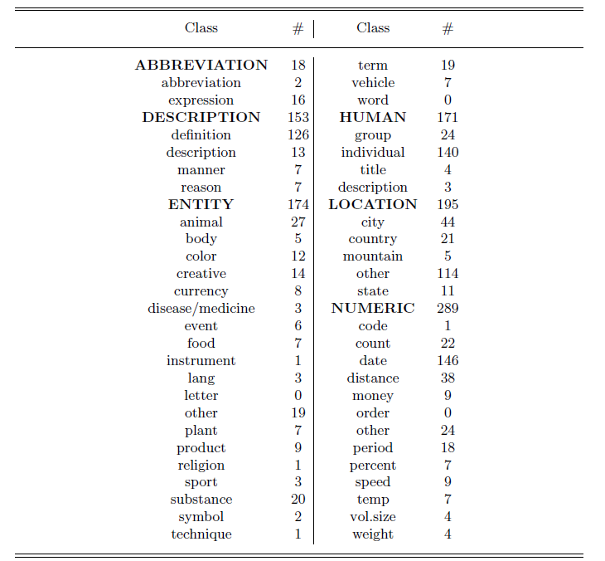
A taxonomy for question classification

Slide 20
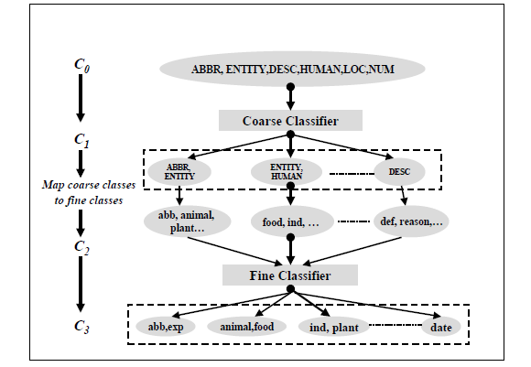
Example: A hierarchical QC Classifier
The initial confusion set of any question is C₀ (coarse classes)
The coarse classifier determines a set of preferred labels, C₁µC₀, with |C₁|<5 (tunable)
Each coarse label is expanded to a set of fine labels using the fixed hierarchy to yield C₂
This process continues now on the fine labels, to yield C₃ µ C₂
Output C₁, C₃ (or continue)

Slide 21
1 Vs All: Learning Architecture
k label nodes; n input features, nk weights.
Evaluation: Winner Take All
Training: Each set of n weights, corresponding to the i-th label, is trained
Independently, given its performance on example x, and
Independently of the performance of label j on x.
Hence: Local learning; only the final decision is global, (Winner Takes All (WTA)).
However, this architecture allows multiple learning algorithms; e.g., see the implementation in the SNoW/LbJava Multi-class Classifier
Targets (each an LTU)
Weighted edges (weight vectors)
Features

Slide 22
Recall: Winnow’s Extensions
Positive
w⁺
Negative
w⁻
Winnow learns monotone Boolean functions
We extended to general Boolean functions via
“Balanced Winnow”
2 weights per variable;
Decision: using the “effective weight”,
the difference between w⁺ and w⁻
This is equivalent to the Winner take all decision
Learning: In principle, it is possible to use the 1-vs-all rule and update each set of n weights separately, but we suggested the “balanced” Update rule that takes into account how both sets of n weights predict on example x
Can this be generalized to the case of k labels, k >2?
We need a “global” learning approach

Slide 23
Extending Balanced
In a 1-vs-all training you have a target node that represents positive examples and target node that represents negative examples.
Typically, we train each node separately (mine/not-mine example).
Rather, given an example we could say: this is more a + example than a – example.
We compared the activation of the different target nodes (classifiers) on a given example. (This example is more class + than class -)
Can this be generalized to the case of k labels, k >2?
Notes:
Brief introduction to St. Out. problems
HIGHLIGHT THE DIFFERENCE BETWEEN LOCAL AND GLOBAL LEARNING!!!
Start w/ probably the simplest St. Out. problem: MULTICLASS!!!
where instead of viewing the label as a single integer, we can view it as a bit vector
ALONG WITH THE RESTIRCTION saying “EXACLTY ONE....”
Then, as we saw in the previous section, we can learn a collection of functions in two ways.
OvA attempts to have each function predict a single bit w/o looking at the rest! We call this LOCAL learning.
CC also learns the collection, but in a way the RESPECTS THE GLOB REST. LEARNS GLOBALLY all functions toghehter.
(LOOK AT SLIDE)!
Sequence tasks:
***** EX POS TAGGING,
TWO WAYS TO VIEW LABEL ::: Collection of word/pos pairs
::: Single label (WHOLE SENT TAG).
LEARN IN TWO WAYS ::: Fucnt to predict each POS tag sep.
::: Funct to predict whole tag seq at once.
Struct output:
arbitrary global constraints
**** LOCAL FUNCTIONS DON’T HAVE ACCESS TO THE GLOBAL CONSTRAINTS
--> NO CHANCE!!

Slide 24
Where are we?
Introduction
Combining binary classifiers
One-vs-all
All-vs-all
Error correcting codes
Training a single (global) classifier
Multiclass SVM
Constraint classification

Slide 25
Recall: Margin for binary classifiers
The margin of a hyperplane for a dataset is the distance between the hyperplane and the data point nearest to it.
-
-
+
+
+
-
+
+
-
-
-
-
+
+
+
-
-
-
-
-
-
-
-
-
-
Margin with respect to this hyperplane
-

Slide 26
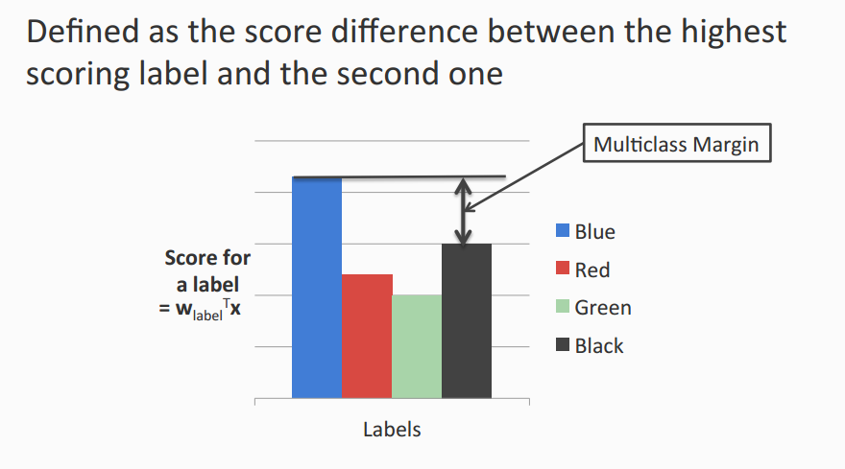
Multiclass Margin

Slide 27
Multiclass SVM (Intuition)
Recall: Binary SVM
Maximize margin
Equivalently,
Minimize norm of weight vector, while keeping the closest points to the hyperplane with a score §1
Multiclass SVM
Each label has a different weight vector (like one-vs-all)
Maximize multiclass margin
Equivalently,
Minimize total norm of the weight vectors while making sure that the true label scores at least 1 more than the second best one.

Slide 28
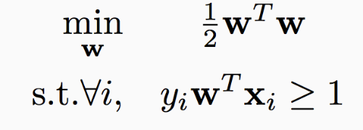
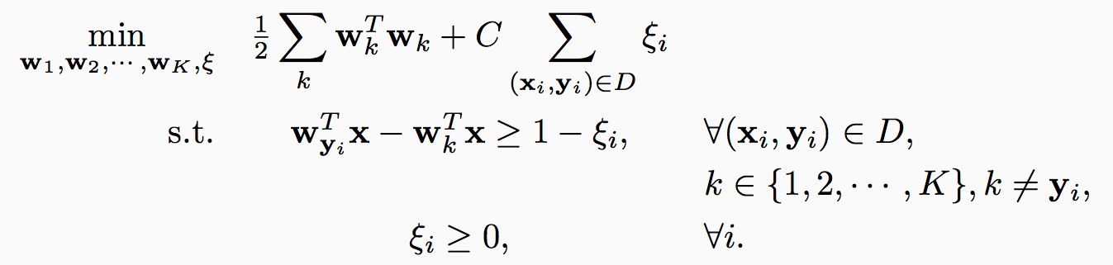
Multiclass SVM in the separable case
Recall hard binary SVM
Size of the weights. Effectively, regularizer
The score for the true label is higher than the score for any other label by 1

Slide 29
Multiclass SVM: General case
Total slack. Effectively, don’t allow too many examples to violate the margin constraint
Size of the weights. Effectively, regularizer
The score for the true label is higher than the score for any other label by 1
Slack variables. Not all examples need to satisfy the margin constraint.
Slack variables can only be positive

Slide 30
Multiclass SVM: General case
Total slack. Effectively, don’t allow too many examples to violate the margin constraint
Size of the weights. Effectively, regularizer
The score for the true label is higher than the score for any other label by
1 - »_{i}
Slack variables. Not all examples need to satisfy the margin constraint.
Slack variables can only be positive

Slide 31
Multiclass SVM
Generalizes binary SVM algorithm
If we have only two classes, this reduces to the binary (up to scale)
Comes with similar generalization guarantees as the binary SVM
Can be trained using different optimization methods
Stochastic sub-gradient descent can be generalized
Try as exercise

Slide 32
Multiclass SVM: Summary
Training:
Optimize the “global” SVM objective
Prediction:
Winner takes all
argmax_{i} w_{i}^{T}x
With K labels and inputs in <^{n}, we have nK weights in all
Same as one-vs-all
Why does it work?
Why is this the “right” definition of multiclass margin?
A theoretical justification, along with extensions to other algorithms beyond SVM is given by “Constraint Classification”
Applies also to multi-label problems, ranking problems, etc.
[Dav Zimak; with D. Roth and S. Har-Peled]

Slide 33
Constraint Classification
The examples we give the learner are pairs (x,y), y 2 {1,…k}
The “black box learner” (1 vs. all) we described might be thought of as a function of x only but, actually, we made use of the labels y
How is y being used?
y decides what to do with the example x; that is, which of the k classifiers should take the example as a positive example (making it a negative to all the others).
How do we predict?
Let: f_{y}(x) = w_{y}^{T} ¢ x
Then, we predict using: y* = argmax_{y=1,…k} f_{y}(x)
Equivalently, we can say that we predict as follows:
Predict y iff
8 y’ 2 {1,…k}, y’:=y (w_{y}^{T} – w_{y’}^{T} ) ¢ x ¸ 0 (**)
So far, we did not say how we learn the k weight vectors w_{y} (y = 1,…k)
Can we train in a way that better fits the way we predict?
What does it mean?
Is it better in any well defined way?
Notes:
Brief introduction to St. Out. problems
HIGHLIGHT THE DIFFERENCE BETWEEN LOCAL AND GLOBAL LEARNING!!!
Start w/ probably the simplest St. Out. problem: MULTICLASS!!!
where instead of viewing the label as a single integer, we can view it as a bit vector
ALONG WITH THE RESTIRCTION saying “EXACLTY ONE....”
Then, as we saw in the previous section, we can learn a collection of functions in two ways.
OvA attempts to have each function predict a single bit w/o looking at the rest! We call this LOCAL learning.
CC also learns the collection, but in a way the RESPECTS THE GLOB REST. LEARNS GLOBALLY all functions toghehter.
(LOOK AT SLIDE)!
Sequence tasks:
***** EX POS TAGGING,
TWO WAYS TO VIEW LABEL ::: Collection of word/pos pairs
::: Single label (WHOLE SENT TAG).
LEARN IN TWO WAYS ::: Fucnt to predict each POS tag sep.
::: Funct to predict whole tag seq at once.
Struct output:
arbitrary global constraints
**** LOCAL FUNCTIONS DON’T HAVE ACCESS TO THE GLOBAL CONSTRAINTS
--> NO CHANCE!!

Slide 34
Linear Separability for Multiclass
We showed: if pairs of labels are separable (a reasonable assumption) than in some higher dimensional space, the problem is linearly separable.
We are learning k n-dimensional weight vectors, so we can concatenate the k weight vectors into
w= (w₁, w₂,…w_{k}) 2 R^{nk}
Key Construction: (Kesler Construction; Zimak’s Constraint Classification)
We will represent each example (x,y), as an nk-dimensional vector, x_{y}, with x embedded in the y-th part of it (y=1,2,…k) and the other coordinates are 0.
E.g., x_{y} = (0,x,0,0) ∈ R^{kn} (here k=4, y=2)
Now we can understand the n-dimensional decision rule:
Predict y iff 8 y’ 2 {1,…k}, y’:=y (w_{y}^{T} – w_{y’}^{T} ) ¢ x ¸ 0 (**)
Equivalently, in the nk-dimensional space.
Predict y iff 8 y’ 2 {1,…k}, y’:=y w^{T} ¢ (x_{y} – x_{y’}) ≡ w^{T} ¢ x_{yy’} ¸ 0
Conclusion: The set (x_{yy’} , + ) ≡ (x_{y} – x_{y’} , +) is linearly separable from the
set (-x_{yy’} , - ) using the linear separator w 2 R^{kn} ’
We solved the voroni diagram challenge.
Notice: This is just a representational trick. We did not say how to learn the weight vectors.
Notes:
Brief introduction to St. Out. problems
HIGHLIGHT THE DIFFERENCE BETWEEN LOCAL AND GLOBAL LEARNING!!!
Start w/ probably the simplest St. Out. problem: MULTICLASS!!!
where instead of viewing the label as a single integer, we can view it as a bit vector
ALONG WITH THE RESTIRCTION saying “EXACLTY ONE....”
Then, as we saw in the previous section, we can learn a collection of functions in two ways.
OvA attempts to have each function predict a single bit w/o looking at the rest! We call this LOCAL learning.
CC also learns the collection, but in a way the RESPECTS THE GLOB REST. LEARNS GLOBALLY all functions toghehter.
(LOOK AT SLIDE)!
Sequence tasks:
***** EX POS TAGGING,
TWO WAYS TO VIEW LABEL ::: Collection of word/pos pairs
::: Single label (WHOLE SENT TAG).
LEARN IN TWO WAYS ::: Fucnt to predict each POS tag sep.
::: Funct to predict whole tag seq at once.
Struct output:
arbitrary global constraints
**** LOCAL FUNCTIONS DON’T HAVE ACCESS TO THE GLOBAL CONSTRAINTS
--> NO CHANCE!!

Slide 35
Constraint Classification
Training:
[We first explain via Kesler’s construction; then show we don’t need it]
Given a data set {(x,y)}, (m examples) with x 2 R^{n}, y 2 {1,2,…k}
create a binary classification task (in R^{kn}):
(x_{y} - x_{y’}, +), (x_{y’} – x_{y} -), for all y’ : = y (2m(k-1) examples)
Here x_{y} 2 R^{kn}
Use your favorite linear learning algorithm to train a binary classifier.
Prediction:
Given an nk dimensional weight vector w and a new example x, predict: argmax_{y} w^{T} x_{y}

Slide 36
Details: Kesler Construction & Multi-Class Separability
If (x,i) was a given n-dimensional example (that is, x has is labeled i, then
x_{ij}, 8 j=1,…k, j:= i, are positive examples in the nk-dimensional space. –x_{ij} are negative examples.
Transform Examples
2>4
2>1
2>1
2>3
2>4
2>3
i>j f_{i}(x) - f_{j}(x) > 0
w_{i} ⋅ x - w_{j} ⋅ x > 0
W ⋅ X_{i} - W ⋅ X_{j} > 0
W ⋅ (X_{i} - X_{j}) > 0
W ⋅ X_{ij} > 0
X_{i} = (0,x,0,0) ∈ R^{kd}
X_{j} = (0,0,0,x) ∈ R^{kd}
X_{ij} = X_{i} - X_{j} = (0,x,0,-x)
W = (w₁,w₂,w₃,w₄) ∈ R^{kd}
Notes:
(LOOK AT SLIDE)!
Each example is labeled with a set of constraints.
Then, to maintain these preferences, we must maintain
fi > fj
Linar case, we have
wi.x - wj.x > 0
By rewriting all in one vector
(W = (w1,...))
defining Xi = x in the ith component of Zero vector
we can define NEW EXAMPLES
X IJ
Now, the only thing to learn is W!!!!
[CLICK]
Graphically, this produces a bunch of examples
XIJ -- here we dipict also -XIJ as negative examples so that it is clear we are looking for a BINARY SEPARATION!

Slide 37
Kesler’s Construction (1)
y = argmax_{i=(r,b,g,y)} w_{i}.x
w_{i} , x ∈ R^{n}
Find w_{r},w_{b},w_{g},w_{y} ∈ R^{n} such that
w_{r}.x > w_{b}.x
w_{r}.x > w_{g}.x
w_{r}.x > w_{y}.x
H = R^{kn}
Notes:
First noticed by Kesler in about 1965
Goal
learn MC classifier
wta (argmax) over linear functions
Each example
(x, RED) written as constraints
RED < BLUE, etc...
Learning goal
find weight vectors such that
v_red .x > v_blue .x
etc...

Slide 38
Kesler’s Construction (2)
Let w = (w_{r},w_{b},w_{g},w_{y} ) ∈ R^{kn}
Let 0^{n}, be the n-dim zero vector
w_{r}.x > w_{b}.x ⬄ w.(x,-x,0^{n},0^{n}) > 0 ⬄ w.(-x,x,0^{n},0^{n}) < 0
w_{r}.x > w_{g}.x ⬄ w.(x,0^{n},-x,0^{n}) > 0 ⬄ w.(-x,0^{n},x,0^{n}) < 0
w_{r}.x > w_{y}.x ⬄ w.(x,0^{n},0^{n},-x) > 0 ⬄ w.(-x,0^{n},0^{n} ,x) < 0
x
-x
-x
x
Notes:
Conditions can be rewritten in kd dim
blowup of 4 here
Let
v – concatenation of 4 d-dim weight vectors
0^d – d-dim zero vec
Rewrite v_red .x > v_blue .x as
BOLD(V) dot a pt in high dim > 0
This is a positive point
Also, a negative point
-FOR LINEAR CASE, REDUNDANT

Slide 39
Kesler’s Construction (3)
Let
w = (w₁, ..., w_{k}) ∈ R^{n} x ... x R^{n} = R^{kn}
x_{ij} = (0^{(i-1)n}, x, 0^{(k-i)n}) – (0^{(j-1)n}, –x, 0^{(k-j)n}) ∈ R^{kn}
Given (x, y) ∈ R^{n} x {1,...,k}
For all j ≠ y (all other labels)
Add to P⁺(x,y), (x_{yj}, 1)
Add to P⁻(x,y), (–x_{yj}, -1)
P⁺(x,y) has k-1 positive examples (∈ R^{kn})
P⁻(x,y) has k-1 negative examples (∈ R^{kn})
x
-x
Notes:
The general MC setting for linear functions is exactly the same
BOLD (V) is the weight vector we try to learn
BOLD (xij) is example in kd dim that says that
i is preferred over j for example x
We create Positive examples where the winning class is prefered over all others
Negative examples, the same way.

Slide 40
Learning via Kesler’s Construction
Given (x₁, y₁), ..., (x_{N}, y_{N}) ∈ R^{n} x {1,...,k}
Create
P⁺ = ∪ P⁺(x_{i},y_{i})
P– = ∪ P–(x_{i},y_{i})
Find w = (w₁, ..., w_{k}) ∈ R^{kn}, such that
w.x separates P⁺ from P–
One can use any algorithm in this space: Perceptron, Winnow, SVM, etc.
To understand how to update the weight vector in the n-dimensional space, we note that
w^{T} ¢ x_{yy’} ¸ 0 (in the nk-dimensional space)
is equivalent to:
(w_{y}^{T} – w_{y’}^{T} ) ¢ x ¸ 0 (in the n-dimensional space)
Notes:
The goal of learning
-SEPARATE positive from negative (P+ from P-)
Notice the output:
- interpret the components of BOLD(v)
as class weight vectors
- a winner take all case
Interpretation of examples in kd
each point specifies that i is preferred over j for example x
linear case, these constraints ensure wta
Any WTA function can be learned
- by perceptron convergence theorem

Slide 41
Perceptron in Kesler Construction
A perceptron update rule applied in the nk-dimensional space due to a mistake in w^{T} ¢ x_{ij} ¸ 0
Or, equivalently to (w_{i}^{T} – w_{j}^{T} ) ¢ x ¸ 0 (in the n-dimensional space)
Implies the following update:
Given example (x,i) (example x 2 R^{n}, labeled i)
8 (i,j), i,j = 1,…k, i := j (***)
If (w_{i}^{T} - w_{j}^{T} ) ¢ x < 0 (mistaken prediction; equivalent to w^{T} ¢ x_{ij} < 0 )
w_{i} ← w_{i} +x (promotion) and w_{j} ← w_{j} – x (demotion)
Note that this is a generalization of balanced Winnow rule.
Note that we promote w_{i} and demote k-1 weight vectors w_{j}
Notes:
Brief introduction to St. Out. problems
HIGHLIGHT THE DIFFERENCE BETWEEN LOCAL AND GLOBAL LEARNING!!!
Start w/ probably the simplest St. Out. problem: MULTICLASS!!!
where instead of viewing the label as a single integer, we can view it as a bit vector
ALONG WITH THE RESTIRCTION saying “EXACLTY ONE....”
Then, as we saw in the previous section, we can learn a collection of functions in two ways.
OvA attempts to have each function predict a single bit w/o looking at the rest! We call this LOCAL learning.
CC also learns the collection, but in a way the RESPECTS THE GLOB REST. LEARNS GLOBALLY all functions toghehter.
(LOOK AT SLIDE)!
Sequence tasks:
***** EX POS TAGGING,
TWO WAYS TO VIEW LABEL ::: Collection of word/pos pairs
::: Single label (WHOLE SENT TAG).
LEARN IN TWO WAYS ::: Fucnt to predict each POS tag sep.
::: Funct to predict whole tag seq at once.
Struct output:
arbitrary global constraints
**** LOCAL FUNCTIONS DON’T HAVE ACCESS TO THE GLOBAL CONSTRAINTS
--> NO CHANCE!!

Slide 42
Conservative update
The general scheme suggests:
Given example (x,i) (example x 2 R^{n}, labeled i)
8 (i,j), i,j = 1,…k, i := j (***)
If (w_{i}^{T} - w_{j}^{T} ) ¢ x < 0 (mistaken prediction; equivalent to w^{T} ¢ x_{ij} < 0 )
w_{i} ← w_{i} +x (promotion) and w_{j} ← w_{j} – x (demotion)
Promote w_{i} and demote k-1 weight vectors w_{j}
A conservative update: (SNoW and LBJava’s implementation):
In case of a mistake: only the weights corresponding to the target node i and that closest node j are updated.
Let: j* = argmax_{j=1,…k} w_{j}^{T} ¢ x (highest activation among competing labels)
If (w_{i}^{T} – w_{j*}^{T} ) ¢ x < 0 (mistaken prediction)
w_{i} ← w_{i} +x (promotion) and w_{j*} ← w_{j*} – x (demotion)
Other weight vectors are not being updated.
Notes:
Brief introduction to St. Out. problems
HIGHLIGHT THE DIFFERENCE BETWEEN LOCAL AND GLOBAL LEARNING!!!
Start w/ probably the simplest St. Out. problem: MULTICLASS!!!
where instead of viewing the label as a single integer, we can view it as a bit vector
ALONG WITH THE RESTIRCTION saying “EXACLTY ONE....”
Then, as we saw in the previous section, we can learn a collection of functions in two ways.
OvA attempts to have each function predict a single bit w/o looking at the rest! We call this LOCAL learning.
CC also learns the collection, but in a way the RESPECTS THE GLOB REST. LEARNS GLOBALLY all functions toghehter.
(LOOK AT SLIDE)!
Sequence tasks:
***** EX POS TAGGING,
TWO WAYS TO VIEW LABEL ::: Collection of word/pos pairs
::: Single label (WHOLE SENT TAG).
LEARN IN TWO WAYS ::: Fucnt to predict each POS tag sep.
::: Funct to predict whole tag seq at once.
Struct output:
arbitrary global constraints
**** LOCAL FUNCTIONS DON’T HAVE ACCESS TO THE GLOBAL CONSTRAINTS
--> NO CHANCE!!

Slide 43
Multiclass Classification Summary 1: Multiclass Classification
From the full dataset, construct three binary classifiers, one for each class
w_{blue}^{T}x > 0 for blue inputs
w_{org}^{T}x > 0 for orange inputs
w_{black}^{T}x > 0 for black inputs
Notation: Score for blue label
Winner Take All will predict the right answer. Only the correct label will have a positive score

Slide 44
Multiclass Classification Summary 2: One-vs-all may not always work
Red points are not separable with a single binary classifier
The decomposition is not expressive enough!
w_{blue}^{T}x > 0 for blue inputs
w_{org}^{T}x > 0 for orange inputs
w_{black}^{T}x > 0 for black inputs
???

Slide 45
Summary 3: Local Learning: One-vs-all classification
Easy to learn
Use any binary classifier learning algorithm
Potential Problems
Calibration issues
We are comparing scores produced by K classifiers trained independently. No reason for the scores to be in the same numerical range!
Train vs. Train
Does not account for how the final predictor will be used
Does not optimize any global measure of correctness
Yet, works fairly well
In most cases, especially in high dimensional problems (everything is already linearly separable).

Slide 46
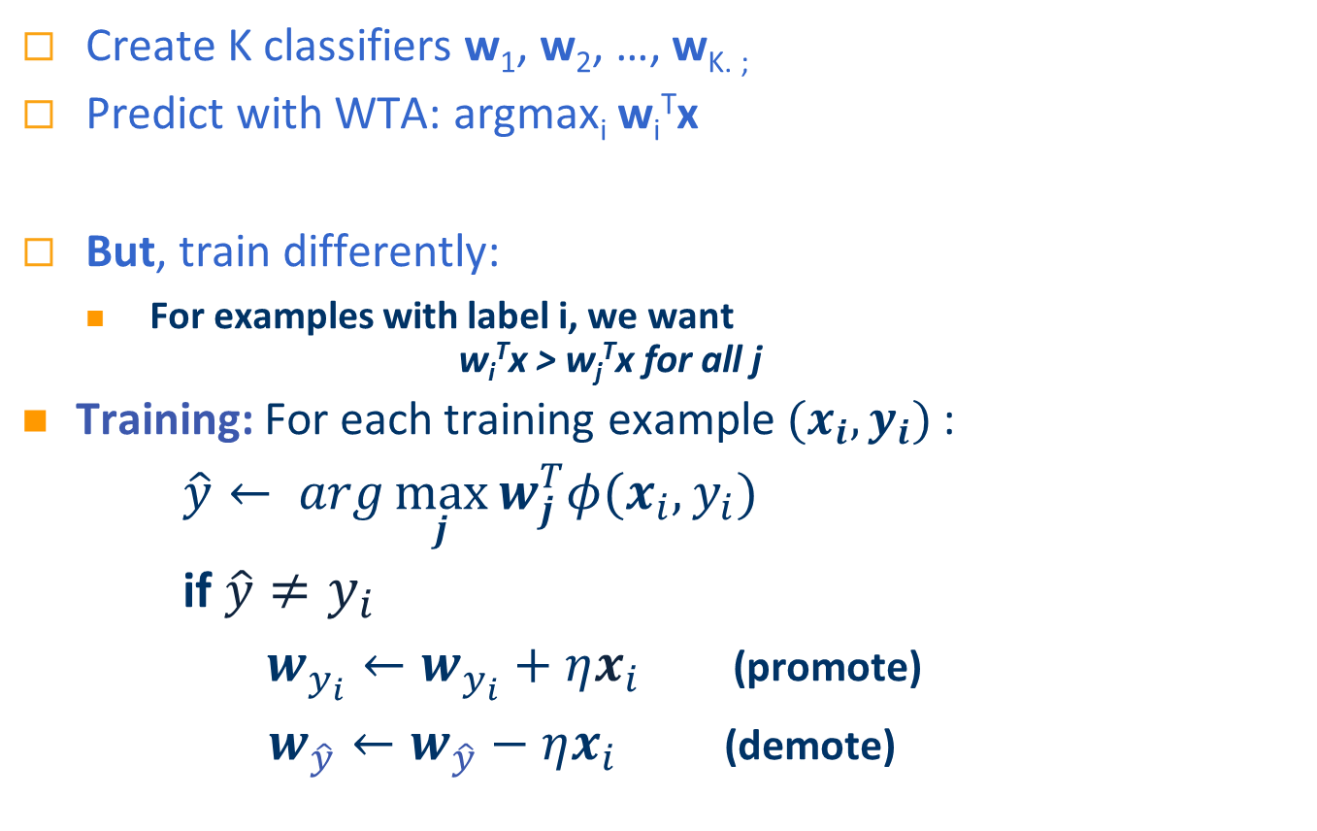
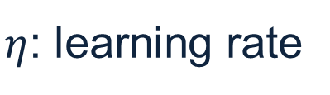
Summary 4: Global Multiclass Approach [Constraint Classification, Har-Peled et. al ‘02]
Create K classifiers w₁, w₂, …, w_{K. ;}
Predict with WTA: argmax_{i} w_{i}^{T}x
But, train differently:
For examples with label i, we want w_{i}^{T}x > w_{j}^{T}x for all j
Training: For each training example $(x_{i},y_{i})$:
$\hat{y}← arg\max_{j}{w_{j}^{T}φ(x_{i},y_{i})}$
if $\hat{y}≠y_{i}$
$w_{y_{i}}←w_{y_{i}}+ηx_{i}$ (promote)
$w_{\hat{y}}←w_{\hat{y}}−ηx_{i}$ (demote)
$η$: learning rate

Slide 47
Significance
The hypothesis learned above is more expressive than when the OvA assumption is used.
Any linear learning algorithm can be used, and algorithmic-specific properties are maintained (e.g., attribute efficiency if using winnow.)
E.g., the multiclass support vector machine can be implemented by learning a hyperplane to separate P(S) with maximal margin.
As a byproduct of the linear separability observation, we get a natural notion of a margin in the multi-class case, inherited from the binary separability in the nk-dimensional space.
Given example x_{ij} 2 R^{nk}, margin(x_{ij},w) = min_{ij} w^{T} ¢ x_{ij}
Consequently, given x 2 R^{n}, labeled i
margin(x,w) = min_{j} (w_{i}^{T} - w_{j}^{T} ) ¢ x
Notes:
Brief introduction to St. Out. problems
HIGHLIGHT THE DIFFERENCE BETWEEN LOCAL AND GLOBAL LEARNING!!!
Start w/ probably the simplest St. Out. problem: MULTICLASS!!!
where instead of viewing the label as a single integer, we can view it as a bit vector
ALONG WITH THE RESTIRCTION saying “EXACLTY ONE....”
Then, as we saw in the previous section, we can learn a collection of functions in two ways.
OvA attempts to have each function predict a single bit w/o looking at the rest! We call this LOCAL learning.
CC also learns the collection, but in a way the RESPECTS THE GLOB REST. LEARNS GLOBALLY all functions toghehter.
(LOOK AT SLIDE)!
Sequence tasks:
***** EX POS TAGGING,
TWO WAYS TO VIEW LABEL ::: Collection of word/pos pairs
::: Single label (WHOLE SENT TAG).
LEARN IN TWO WAYS ::: Fucnt to predict each POS tag sep.
::: Funct to predict whole tag seq at once.
Struct output:
arbitrary global constraints
**** LOCAL FUNCTIONS DON’T HAVE ACCESS TO THE GLOBAL CONSTRAINTS
--> NO CHANCE!!

Slide 48
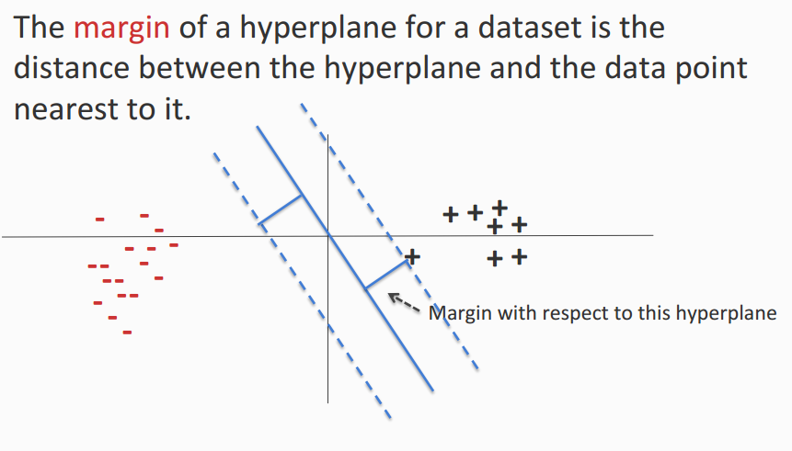
Margin

Slide 49
Multiclass Margin

Slide 50
Constraint Classification
The scheme presented can be generalized to provide a uniform view for multiple types of problems: multi-class, multi-label, category-ranking
Reduces learning to a single binary learning task
Captures theoretical properties of binary algorithm
Experimentally verified
Naturally extends Perceptron, SVM, etc...
It is called “constraint classification” since it does it all by representing labels as a set of constraints or preferences among output labels.
Notes:
SPECIFICALLY, CC is a Framework for small output problems:
MC,ML,CAT, HIER..
Key to unifying these is to
learn a classifier to represent the CONSTRAINTS induced by the Mcat problem
TO reduce MCat to BIN, we
transform each input example to a --> set in higher dim space (pseudo)
each pseudo-example in the pseudo-space is responsible for maintaining a single constraint
Then, a SINGLE BINARY CLASSIFER CAN BE USED to learn these constraints.
Some NICE properties of this:
Can use any binary alg.
Many properties are inherited w/o much (or any) additional work

Slide 51
Multi-category to Constraint Classification
The unified formulation is clear from the following examples:
Multiclass
(x, A) ⇒ (x, (A>B, A>C, A>D) )
Multilabel
(x, (A, B)) ⇒ (x, ( (A>C, A>D, B>C, B>D) )
Label Ranking
(x, (5>4>3>2>1)) ⇒ (x, ( (5>4, 4>3, 3>2, 2>1) )
In all cases, we have examples (x,y) with y ∈ S_{k}
Where S_{k} : partial order over class labels {1,...,k}
defines “preference” relation ( > ) for class labeling
Consequently, the Constraint Classifier is: h: X → S_{k}
h(x) is a partial order
h(x) is consistent with y if (i<j) ∈ y ➔ (i<j) ∈h(x)
Just like in the multiclass we learn one w_{i} 2 R^{n} for each label, the same is done for multi-label and ranking. The weight vectors are updated according with the requirements from y 2 S_{k}
(Consult the Perceptron in Kesler construction slide)
Notes:
The TRANSFORMATIONS are very natural
GO THROUGH!!!
MC:
ML:
LR:
In general, we define a constraint example as one where the labels
partial order
defined by pairwise preferences.
CC classifier produces this order
Then we map the problem to the (PSEUDO) space
where each of the pairwise constraints can be maintained
and LEARN
TRANSITION: I describe this mapping for the linear case.

Slide 52
Properties of Construction (Zimak et. al 2002, 2003)
Can learn any argmax v_{i}.x function (even when i isn’t linearly separable from the union of the others)
Can use any algorithm to find linear separation
Perceptron Algorithm
ultraconservative online algorithm [Crammer, Singer 2001]
Winnow Algorithm
multiclass winnow [ Masterharm 2000 ]
Defines a multiclass margin
by binary margin in R^{kd}
multiclass SVM [Crammer, Singer 2001]
Notes:
Take a moment to go over some of the implications of the previous construction
1. ANY BINARY classifier can be used -- as long as it respects constraints!!!
2. In the LINEAR CASE, many nice results
1. PERCEPTRON CONVERGENCE implies that ANY argmax function can be learnined
(ulike OvA and other decomp. methods)
2. Related to some recent work in MC setting
perceptron --> Ultraconservative online alg
winnow --> multiclass winnow
3. Not only ALG, but ANALYSIS as well
BEFORE: new bounds were developed.
NOW: extension is easy.
[CLICK]
LOOK at separation in low and high!
Requires just a small amount of tweaking to develop margin bounds and VC bounds.

Slide 53
Margin Generalization Bounds
Linear Hypothesis space:
h(x) = argsort v_{i}.x
v_{i}, x ∈R^{d}
argsort returns permutation of {1,...,k}
CC margin-based bound
γ = min_{(x,y)∈S} min _{(i < j)∈y} v_{i}.x – v_{j}.x
m - number of examples
R - max_{x} ||x||
δ - confidence
C - average # constraints
Notes:
In the common case, where each class is represented using a linear function (vi.x),
we have both margin based generalization bounds and structure-based bounds.
begin with margin
A very natural definition of margin emerges from the CC framework
The classifier will learn decision function whose boundaries are gamma-“far” away from the example points.
In this case, we can make a statement as to the generality of the classifier.
Specifically, for a given confidence level, we guarantee that the error decreases as the margin and number of examples correctly classified increases and decreases if we are required to predict many constraints (C)
----------------
Then one class i is “prefered” over another class j if vi.x > vj.x
We can provide margin-based bounds and Growth function based bounds
A natural definition of margin falls out of this work
simply the the distance between the classifier and the nearest example
draw a padding around the classifier
Then, we can show a bound where the error increases with
C the number of constraints enforced
And decreases with
m more examples
gamma larger margin

Slide 54
VC-style Generalization Bounds
Linear Hypothesis space:
h(x) = argsort v_{i}.x
v_{i}, x ∈R^{d}
argsort returns permutation of {1,...,k}
CC VC-based bound
Performance: even though this is the right thing to do, and differences can be observed in low dimensional cases, in high dimensional cases, the impact is not always significant.
m - number of examples
d - dimension of input space
delta - confidence
k - number of classes
Notes:
Margin bounds are data dependent, however there are additional bounds that depend on the complexity of the classifier involved
Here, this means the number of linear boundaries in the final classification
increase with
k -number of classes
d- dimension
decrese with
m - more examples, (for law of large number reasons)

Slide 55
Beyond MultiClass Classification
Ranking
category ranking (over classes)
ordinal regression (over examples)
Multilabel
x is both red and blue
Complex relationships
x is more red than blue, but not green
Millions of classes
sequence labeling (e.g. POS tagging)
The same algorithms can be applied to these problems, namely, to Structured Prediction
This observation is the starting point for CS546.

Slide 56
(more) Multi-Categorical Output Tasks
Sequential Prediction (y ∈ {1,...,K}⁺)
e.g. POS tagging (‘(NVNNA)’)
“This is a sentence.” ⇒ D V D N
e.g. phrase identification
Many labels: K^{L} for length L sentence
Structured Output Prediction (y ∈ C({1,...,K}⁺))
e.g. parse tree, multi-level phrase identification
e.g. sequential prediction
Constrained by
domain, problem, data, background knowledge, etc...
Notes:
We view SEQ Pred as a classification problem w/ VERY LARGE # of classes
Label is a list of tokens ( each from {1,..,K})
e.g. POS tagging: 50 POStags, --> Seq of len 10 has 50^10 classes
ALSO, STRCUT. OUT. PRED is mult-cat.
assignm labels to a set of variables.
Doesn’t have to be an ordered list
IMPORTANT ASPECT -- CONSTRAINED OUTPUT!
based on domain or problem specification or output type
NOT CLEAR, but SRL example next slide...

Slide 57
Semantic Role Labeling: A Structured-Output Problem
For each verb in a sentence
Identify all constituents that fill a semantic role
Determine their roles
Core Arguments, e.g., Agent, Patient or Instrument
Their adjuncts, e.g., Locative, Temporal or Manner
A0 : leaver
A2 : benefactor
I left my pearls to my daughter-in-law in my will.
A1 : thing left
AM-LOC
Notes:
See what I mean by looking at SRL problem:
SRL problem:
given a sentence and a verb
find parts of the sentence that are ARGS of the verb
“WHO” left “WHAT” to “WHO” or “WHERE”

Slide 58
Semantic Role Labeling
Just like in the multiclass case we can think about local vs. global predictions.
Local: each component learned separately, w/o thinking about other components.
Global: learn to predicting the whole structure.
Algorithm: essentially the same as CC
A0 - A1 A2 AM-LOC
I left my pearls to my daughter-in-law in my will.
Many possible valid outputs
Many possible invalid outputs
Typically, one correct output (per input)
Notes:
There are MANY possible outputs -- different ways to label the sentence
(CLICK) (CLICK)
EVEN MORE complicated ways
(CLICK)
HOWEVER many of them are INVALID.
THE problem dictates that there can not be any overlaping arguments
CONSTRAINS the output space
LATER... I’ll show more detail about modeling the SRL task.
Now, we’ll continue to the different approaches to learning...

